Slide 1

Customer Churn Analysis
A Data-Driven Strategy to Retain Customers & Optimize Revenue
Final Project
Team Data Pioneers
Shady Shaaban Abdelfattah
Yasmine Mohsen Youssef Ahmed
Samar Mostafa Mohamed
Christina Malak Saad Fayek
DIGITAL EGYPT PIONEERS INITIATIVE (DEPI)

Slide 2



Executive Summary
The Problem
Business Impact
The telecom provider is facing a critical retention crisis with a 27% Churn Rate. This attrition has resulted in a loss of 1,732 customers.
This churn translates to a significant financial hit. The company is losing approximately $19.47 Million in annual revenue potential.

Slide 3







Comprehensive Data Pipeline
1. Ingestion
2. Processing
3. Modeling
4. Visualization
Raw Data Source
(7,043 Records)
SQL Server Import
SQL Cleaning Scripts
Null Handling
Data Transformation
Star Schema Design
Fact & Dimension Tables
Relationship Mapping
Power BI Dashboard
DAX Measures
Interactive Reports

Slide 4
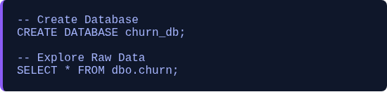

SQL Phase 1- Ingestion & Exploration
All Data 1. SQL
This step involved creating the database and importing the raw dataset.
The primary goal was to explore the general structure rows and columns (31 variables) to identify cleaning requirements.

Slide 5

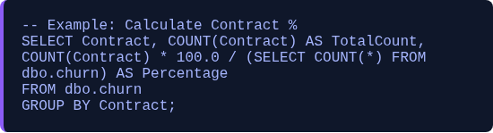
SQL Phase 2: Exploratory Data Analysis (EDA)
EDA 2.sql
This phase aimed to calculate percentages, customer distribution, and key metrics before cleaning.
Vital information about gender ratios contract types and revenue distribution by customer status was extracted.

Slide 6
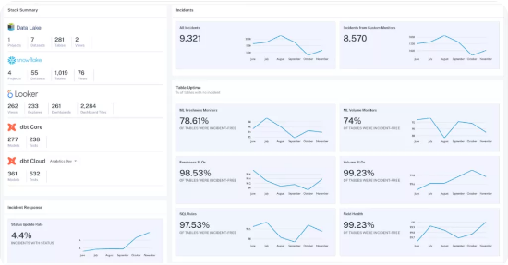

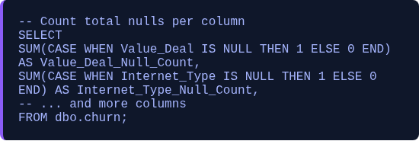
SQL Phase 3: Null Value Assessment
detect nulls3.sql
Precise identification of the location and count of missing values (Nulls) in each column.
This code helped uncover 1,390 missing values in service columns that needed to be addressed before modeling.

Slide 7

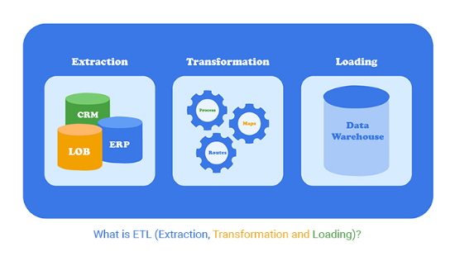
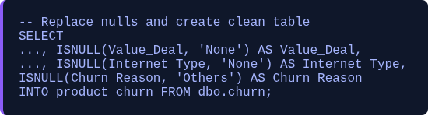
SQL Phase 4: Data Cleaning & Replacement
replace nulls4.sql
The `ISNULL` function was used to replace all missing values with appropriate logical or categorical values ('None' or 'No'). Crucially, the final result was saved into a new clean table called `product_churn`, which serves as the new data source for the model.

Slide 8
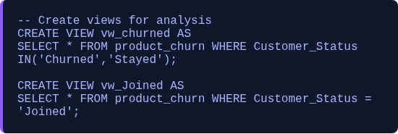
SQL Phase 5: View Creation
create_view 5.sql
To facilitate data modeling and analysis in Power BI, logical views were created based on customer status from the clean `product_churn` table:
•
vw_churned: Includes customers who have Churned or Stayed.
•
vw_Joined: Includes new customers who recently Joined.

Slide 9

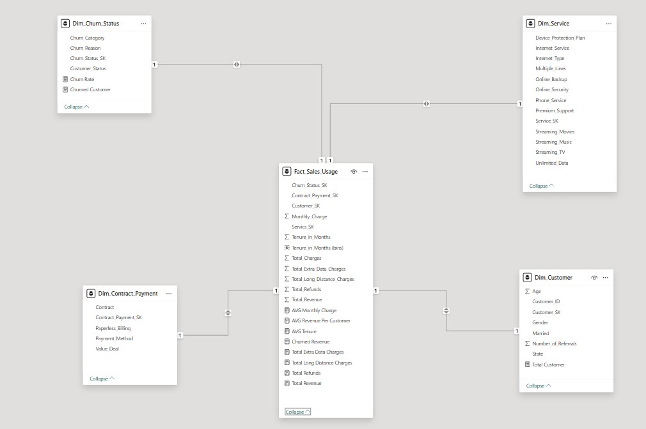
Data Modeling: Star Schema
Star Schema Design
A **Star Schema** model was chosen to simplify the Data Model, facilitating DAX queries in Power BI and improving report performance. The model is based on:
Fact Table: Contains measurable metrics (Total Revenue, Monthly Charge, Total Charges) and is the center of the star.
Dimension Tables: Describe characteristics and details (Customer, Service, Contract, Date) and connect to the Fact table via PK/FK relationships.

Slide 10
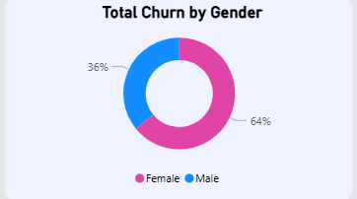
Demographic Churn Analysis
Gender Disparity
Data analysis revealed that female customers are churning at a significantly higher rate than male customers:
•
Female Churn: 64% of total churn.
•
Male Churn: 36% of total churn.
Recommendation: Launch targeted retention campaigns specifically for the female demographic segment.

Slide 11
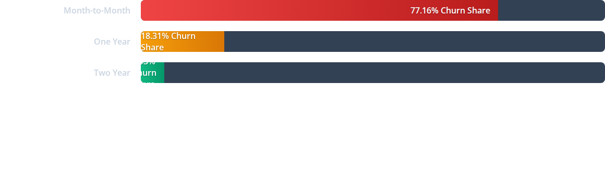

Primary Driver: Contract Type
Critical Finding: Customers on Month-to-Month contracts are the most volatile segment, while long-term contracts (2 years) show exceptional stability.

Slide 12
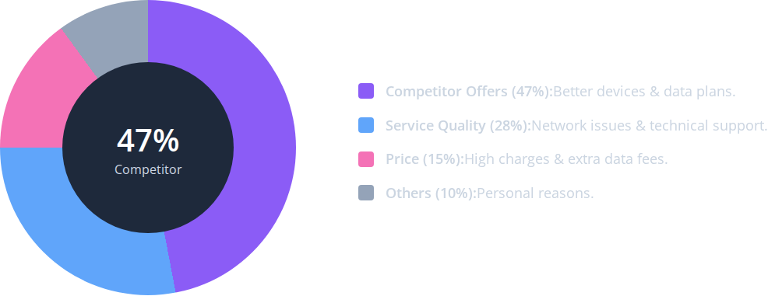
Analysis of Churn Reasons

Slide 13




Geographic Hotspots Analysis
Uttar Pradesh
Tamil Nadu
Maharashtra
Highest churn volume observed. Requires immediate infrastructure review.
High competitor activity detected affecting retention.
Significant churn related to "Network Issues" and support quality.

Slide 14
Strategic Roadmap
We designed a 3-part strategy to reduce churn, respond to competitors, and improve service quality.
Strategy | Action Plan | Expected Impact
Contract Migration | Offer incentives (free streaming, 5% discount) to move Monthly users to 1-Year plans. | Reduce churn by ~10%
Competitive Response | Launch "Data Boost" packages in Tamil Nadu to match competitor speeds. | Retain ~5% of risk pool
Service Recovery | Enhance technical support training and Fiber Optic rollout in Maharashtra. | Improve SAT by 20%

Slide 15


Key Performance Indicators (KPIs)
Here’s a quick overview of our current performance and the targets we aim to achieve.
Key Metrics
Improvement Targets
Monthly Churn Rate
Reduce Churn Rate by 15%
Average Revenue Per User (ARPU)
Increase Average Tenure by 6 Months
Average Customer Tenure
Improve Customer Satisfaction by 20%

Slide 16

Future Scope & Innovation
1. Predictive ML Modeling
Transitioning from descriptive to predictive analysis. Building a Random Forest model to predict customer churn probability 3 months in advance.
2. Real-Time Monitoring
Connecting the Power BI dashboard to live data streams (Real-Time) to generate instant alerts when churn indicators spike.

Slide 17

Thank You
We are now open for your questions.
DEPI - Data Analysis Track | Final Project Discussion

Slide 18




Image Sources
https://montecarlodata.com/wp-content/uploads/2024/09/data-quality-dashboard.png
Source: www.montecarlodata.com
https://chartexpo.com/blog/wp-content/uploads/2024/01/what-is-etl-main.jpg
Source: chartexpo.com
https://www.databricks.com/sites/default/files/2024-04/star-schema-2x.png
Source: www.databricks.com

